Slide 1
Chapter 26
Introduction to
Object-Oriented DBMSs - Concepts

Slide 2
Agenda
-The framework for an object-oriented data model.
-Functional Data Model (FDM)
-Persistent Programming Languages
-OODBMS Perspectives
-The difference between the two-level storage model used by conventional DBMSs and the single-level model used by OODBMSs.
-How pointer swizzling techniques work
-Classification of pointer swizzling
-Accessing an Object
-Persistence Schemes
-Orthogonal persistence

Slide 3
The framework for an object-oriented data model

Slide 4
The framework for an object-oriented data model
Definition of Object-Oriented DBMSs
OODM: A (logical) data model that captures the semantics of objects supported in object-oriented programming.
OODB: A persistent and sharable collection of objects defined by an OODM.
OODBMS: The manager of an OODB.
integrating object-oriented concepts with database systems, namely the Object-Oriented Database Management System (OODBMS). The OODBMS started in the engineering and design domains and has recently also become the favored system for financial and telecommunications applications.

Slide 5
OODBMS must, at a minimum, satisfy:
(1) it must provide database functionality.
(2) it must support object identity.
(3) it must provide encapsulation.
(4) it must support objects with complex state.

Slide 6
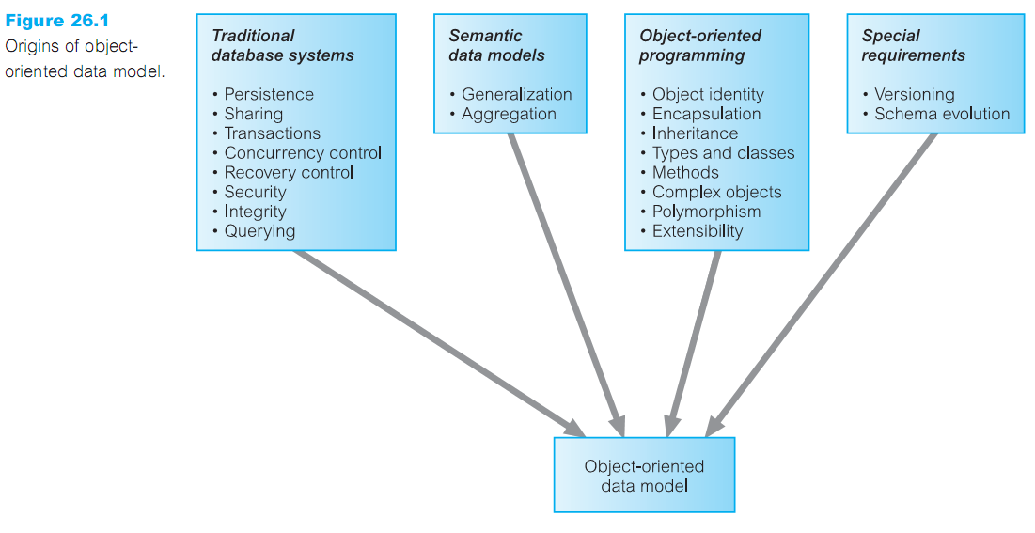
can see that the concepts of object-oriented data models are drawn from different areas, as shown in Figure below.

Slide 7
Functional Data Model (FDM)

Slide 8
Functional Data Model (FDM)
the functional data model (FDM), which is one of the simplest in the family of semantic data models . This model is interesting because it shares certain ideas with the object approach including object identity, inheritance, overloading, and navigational access.
in the FDM, any data retrieval task can be consider as the process of evaluating and returning the result of a function with zero, one, or more . The resulting data model is conceptually simple while at the same time is very expressive.
In the FDM, the are two main modeling primitives
1- Entities
2- Functional relationships

Slide 9
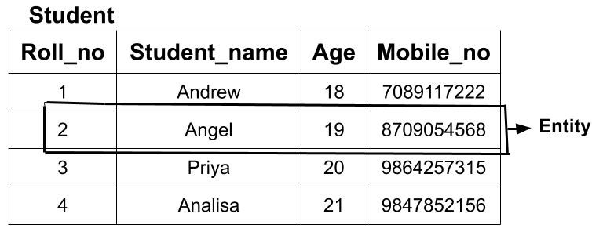
1-Entities are decomposed into (abstract) entity types and printable entity types.
Entity types :correspond to classes of ‘real world’ objects and are declared as functions with zero arguments that return the type ENTITY. EX: Student() ---› ENTITY
Printable entity types are like to the base types in a programming language and include: INTEGER, CHARACTER, STRING, REAL, and DATE. An attribute is deﬁned as a functional relationship Student No(Student) ---› STRING
Name (Student) ---› CHAR
Entity type

Slide 10
We can declare a composite attribute by ﬁrst declaring the attribute to be an entity type and the
declaring its components as functional relationships of the entity type.
Name () ---› ENTITY
Name (Student) ---› NAME
FName (Name) ---› STRING
LName (Name) ---› STRING
2- Functional Relationships
Functions with arguments model not only the properties (attributes) of entity types but also relationships between entity types.
Each relationship may have an inverse relationship deﬁned.
Manages (Staff) ---›› PropertyForRent
ManagedBy (PropertyForRent) ---› Staff INVERSE OF Manages
Note: the double-headed arrow(---››) is used to represent a one-to-many relationship &Many-to-many relationships can be modeled by using the double-headed arrow in both directions.
The FDM also supports multi-valued functions:
ViewDate (Client, PropertyForRent) ---› DATE

Slide 11
Persistent Programming Languages

Slide 12
Persistent Programming Languages
Persistent Programming Languages. A language that provides its users with the ability to (transparently) keep data across successive executions of a program, and even allows such data to be used by many different programs.
Data in a persistent programming language is different from an OODBMS it independent of any program, able to exist after the execution and lifetime of the code that created it.
Database Programming Languages. A language that integrates some ideas from the database programming model with features of traditional programming language
In contrast, a database programming language is distinguished from a persistent programming language by its integration of features beyond persistence, such as transaction management, concurrency control, and recovery.

Slide 13
OODBMS Perspectives

Slide 14
Modern DBMSs are characterized by their support of the following features
1- A data model: A particular way of describing data, relationships between data, and constraints on the data.
2- Data persistence: The ability for data to outlive the execution of a program and possibly the lifetime of the program itself.
3- Data sharing :The ability for multiple applications (or instances of the same one) to access common data, possibly at the same time.
4- Reliability :The assurance that the data in the database is protected from hardware and software failures.
5-Scalability: The ability to operate on large amounts of data in simple ways.

Slide 15
6- Security and integrity :The protection of the data against unauthorized access, and the assurance that the data conforms to specified correctness and consistency rules.
7- Distribution :The ability to physically distribute a logically interrelated collection of shared data over a computer network, preferably making the distribution transparent to the user.
In contrast, traditional programming languages provide constructs for procedural control and for data and functional abstraction, but lack built-in support for many of the above database features. While each is useful in its respective domain, there exists an increasing number of applications

Slide 16
The difference between the two-level storage model used by conventional DBMSs and the single-level model used by OODBMSs.

Slide 17
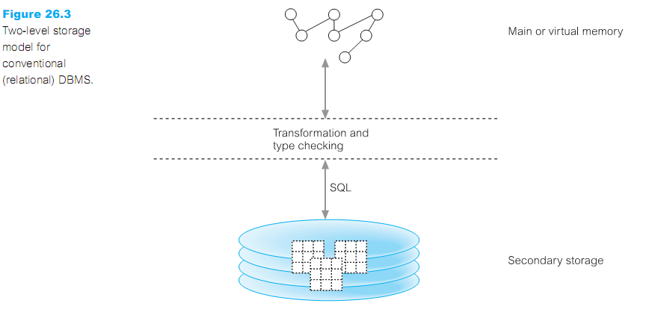
Conventional DBMSs have a two-level storage model the application storage model in main or virtual memory, and the database storage model on disk

Slide 18
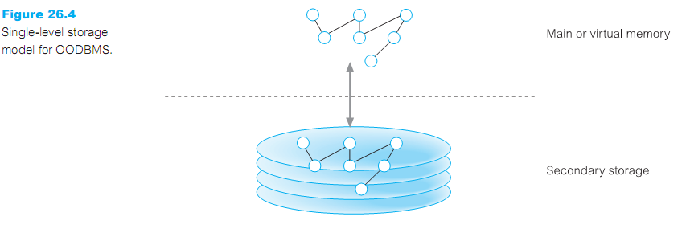
an OODBMS tries to give the illusion of a single-level storage model, with a similar
representation in both memory and in the database stored on disk

Slide 19
How pointer swizzling techniques work

Slide 20
How pointer swizzling techniques work
Pointer swizzling (object faulting):The operation of converting object identifiers to main
memory pointers, and back again. The aim of pointer swizzling is to optimize access to objects.
Techniques pointer swizzling that can be employed
1-No swizzling
*The easiest implementation of faulting objects into and out of memory is not to do any
swizzling at all.
*faulted objects into memory by the implicitly object manager and is passed back to the
application containing the object’s OID
* The OID is used every time the object is accessed.
*This requires that the system maintain some type of lookup table so that the object’s virtual memory pointer can be located and then used to access the object.
*As the lookup is required on each object access, this could be inefficient if the same object is
accessed repeatedly.

Slide 21
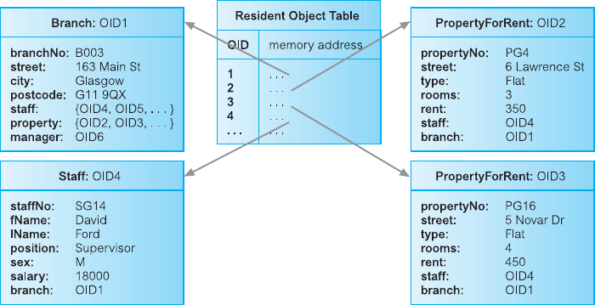

Slide 22
How pointer swizzling techniques work
2- Object referencing
*To be able to swizzle a persistent object’s OID to a virtual memory pointer, a mechanism
is required to distinguish between resident and non-resident objects. Most techniques are variations of either edge marking or node marking.
Considering virtual memory as a directed graph consisting of objects as nodes and references as directed edges, edge marking marks every object pointer with a tag bit. If thebit is set, then the reference is to a virtual memory pointer; otherwise, it is still pointing to an OID and needs to be swizzled when the object it refers to is faulted into the application’s memory space. Node marking requires that all object references are immediately converted to virtual memory pointers when the object is faulted into memory. The ﬁrst approach is a software-based technique but the second approach can be implemented using software- or hardware-based techniques.

Slide 23
How pointer swizzling techniques work
3-Hardware-based schemes
*Hardware-based swizzling uses virtual memory access protection violations to detect
accesses to non-resident objects .
*These schemes use the standard virtual memory hardware to trigger the transfer of persistent data from disk to main memory.
*The hardware approach has been used in several commercial and research systems .
*advantage of the hardware-based approach is that accessing memory-resident persistent objects is just as efficient as accessing transient objects because the hardware
approach avoids the overhead of residency checks incurred by software approaches.

Slide 24
How pointer swizzling techniques work
* disadvantage of the hardware-based approach is that it makes the provision of many useful kinds of database functionality much more difficult, such as fine-grained locking, referential integrity, recovery, and flexible buffer management policies. , the
hardware approach limits the amount of data that can be accessed during a
transaction to the size of virtual memory. This limitation could be overcome by using
some form of garbage collection to reclaim memory space, although this would add
overhead and complexity to the system.

Slide 25
Classification of pointer swizzling

Slide 26
Classification of pointer swizzling
Pointer swizzling techniques can be classified according to the following three
dimensions:
1- Copy versus in-place swizzling: When faulting objects in, the data can either be copied into the application’s local object cache or it can be accessed in place within the object manager’s page cache .
2- Eager versus lazy swizzling: eager swizzling is the swizzling of all OIDs for persistent objects on all data pages used by the application before any object can be accessed. Lazy swizzling swizzles pointers only as they are accessed or discovered.
3- Direct versus indirect swizzling: With direct swizzling, the virtual memory pointer of the referenced object is placed directly in the swizzled pointer; with indirect
swizzling, the virtual memory pointer is placed in an intermediate object, which acts as a placeholder for the actual object.

Slide 27
Accessing an Object

Slide 28
Accessing an Object
How an object is accessed on secondary storage
Steps in accessing a record using a conventional DBMS with a two-level storage model, we find
that the steps, illustrated in Figure
*The DBMS determines the page on secondary storage that contains the required record using indexes or table scans.
*The DBMS then reads that page from secondary storage and copies it into its cache.
*The DBMS subsequently transfers the required parts of the record from the cache into the
application’s memory space. Conversions may be necessary to convert the SQL data types into
the application’s data types.
*The application can then update the record’s fields in its own memory space.
*The application transfers the modified fields back to the DBMS cache using SQL, again
requiring conversions between data types.
*Finally, at an appropriate point the DBMS writes the updated page of the cache back to
secondary storage.

Slide 29
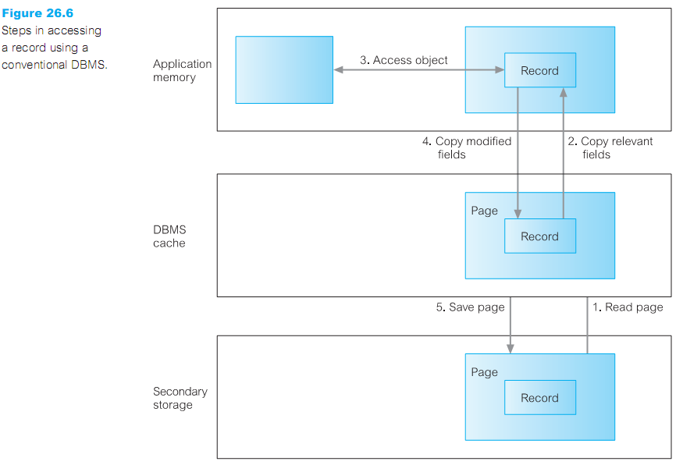

Slide 30
Accessing an Object
In contrast, with a single-level storage model, an OODBMS uses the following steps to
retrieve an object from secondary storage, as illustrated in Figure
-The OODBMS determines the page on secondary storage that contains the required
Object using its OID
-The OODBMS then reads that page from secondary storage and copies it into the
application’s page cache within its memory space.
- The OODBMS may then carry out a number of conversions, such as:
*swizzling references (pointers) between objects.
*adding some information to the object’s data structure.
*modifying the data representations for data that has come from a different hardware
platform or programming language.

Slide 31
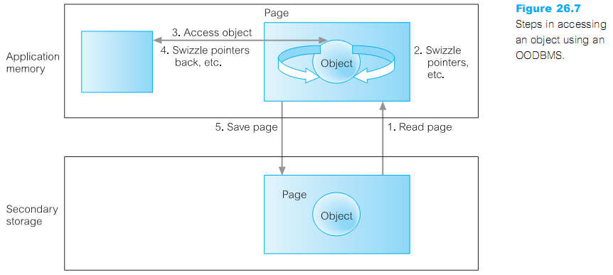
- The application can then directly access the object and update it, as required.
- When the application wishes to make the changes persistent, or when the OODBMS needs to swap the page out of the page cache, the OODBMS may need to carry out similar conversions as listed above, before copying the page back to secondary storage.

Slide 32
Persistence Schemes

Slide 33
Persistence Schemes
The main strategies that can be used to create persistent objects .A DBMS must provide support for the storage of persistent objects, that is, objects that survive after the user session or application program that created them has terminated. This is in contrast to transient objects that last only for the invocation of the program. Persistent objects are retained until they are no longer required, at which point they are deleted.
Persistence Schemes
Three schemes for implementing persistence within an OODBMS:
1- Check pointing
*Some systems implement persistence by copying all or part of a program’s address space to secondary storage. In cases where the complete address space is saved, the program can restart from the checkpoint.
*Check pointing has two main drawbacks: typically, a checkpoint can be used only by the program that created it; second, a checkpoint may contain a large amount of data that is of no use in subsequent executions.

Slide 34
2-Serialization
-Some systems implement persistence by copying the closure of a data structure to disk.
-This process is sometimes called serialization, pickling, or in a distributed computing context, marshaling.
-Serialization has two inherent problems. First, it does not preserve object identity. Second, serialization is not incremental, and so saving small changes to a large data structure is not
efficient.
3-Explicit paging
-Some persistence schemes involve the application programmer explicitly ‘paging’ objects
between the application heap and the persistent store.
-With the explicit paging mechanism, there are two common methods for creating/updating persistent objects: reach ability-based and allocation-based.

Slide 35
-Reachability-based:persistence means that an object will persist if it is reachable from
a persistent root object. Any object can become persistent by adding it to the reachability tree.
- Allocation-based: persistence means that an object is made persistent only if it is explicitly declared at the application program.This can be achieved in severalways, for example:
-->By class: A class is statically declared to be persistent and all instances of the class are made persistent when they are created.
-->By explicit call: An object may be speciﬁed as persistent when it is created or, in some cases, dynamically at runtime.

Slide 36
Orthogonal persistence

Slide 37
Orthogonal Persistence:
An alternative mechanism for providing persistence in a programming language is known as "orthogonal persistence"
Based on three fundamental principles.
1-Persistence independence: The persistence of a data object is independent of how the program manipulates that data object.
2-Data type orthogonally: All data objects should be allowed the full range of persistence whatever their type. There are no special cases where an object is not allowed to be long-lived or is not allowed to be transient.
3-Transitive persistence: The choice of how to identify and provide persistent objects at the language level is independent of the choice of data types in the language.

Slide 38
Advantages of orthogonal persistence:
1- Orthogonal persistence is more convenient for both the programmer and the system.
2-Improved programmer productivity.
3-Improved maintenance.
4-Support for incremental evolution.
5-Automatic referential integrity.
6-Protection mechanisms are consistent and suitable over the whole environment.
Disadvantages of orthogonal persistence:
1- There is some runtime expense in a system at addressing process. Orthogonal persistence promotes transparency. a system with support for sharing among concurrent processes cannot be fully transparent.

Slide 39
Thank you

